Slide 1
An Analysis of the Classification Performance on Bespoke G-Sensor Movement Data from a Mobile Phone
Student: Jerry / Jie Sun
Tutor: Dr. Glavin, Frank
Notes:
Catalogue:
1.What is G-sensor and what is Step Algorithm?
2.How does G-sensor work?
3.Key Algorithms.
4.The demostration of my programme.

Slide 2
What is G-sensor?
What is Step Count Algorithm?
A G-sensor is commonly referred to as an accelerometer. They are used in a wide range of devices like smart phones, vehicles.
Step Count Algorithm is a kind of algorithm which makes use of the G-sensor or other sensors put on human body to calculate how many steps the people walk or run.

Slide 3
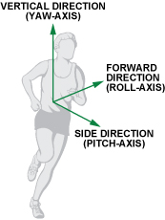
How does G-sensor work?
When a pedestrian is walking on the road, the accelerometer will divide the motion acceleration by three directions, as we can see in the picture below: Vertical Direction, Forward Direction and Side Direction, which can be also called: X, Y and Z Axis.
Fig.1 Definition of each axis.

Slide 4
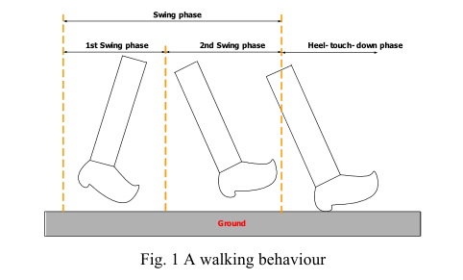
Analysis of Three Axes Accelerations
Fig.2.1. A walking behaviour
Fig. 2.2. Swing phase
Notes:
As we can see in the two pictures, where a , h , g means horizontal acceleration, vertical acceleration and gravity force, respectively.
The strides of the walker are different according to the varying human parameters. The stride depends on several factors such as walking velocity, step frequency and the height of the walker etc.
The horizontal direction acceleration and vertical direction acceleration during the swing phase is denoted in equation below, where θ(t) is inclination angle of the leg at time t.

Slide 5
Key Algorithms
Four kinds of algorithms:
Algorithm 1: Peak Detection Algorithm.
Algorithm 2: Transform Domain Algorithm.
Algorithm 3: Filtering Algorithm.
Algorithm 4: Pattern Recognition Algorithm.
Notes:
This chart on the right shows the total acceleration wave of walking in pocket during 2 seconds from the 2.5 minutes above chart. From the diagram, we can mark some positive and negative peak values, and there are some rules for judging whether peak values are available or not:

Slide 6
1.Peak Detection Algorithm
Four Basic Conditions:
1. Current point is going down.(The Red Point)
2. The previous point is going up.(The Black Point)
3. At least going up twice before coming to positive peak.(The pink lines).
4. The value of the positive peak should be bigger than 1.5g
Positive Peak Choosing

Slide 7
2. Transform Domain Algorithm
One Basic Condition:
1. The duration of two effective adjacent peaks must be longer than 0.2S and shorter than 2s. (Based on common sense)
Deleting the interference signal
Notes:
Here the diagram shows the data caught in 50Hz, 0.02s Period, So if the numbers of data between the two effective adjacent peaks less than 10, means the data is invalid. We judge it is an disturbing singal.

Slide 8
3. Filtering Algorithm
Two Basic Conditions:
The current peak value minus the last valley value must be bigger than the threshold.
The Threshold is Dynamic and related with different walking patterns. (There is one red peak datum being filtered.)
Dynamic Threshold Values

Slide 9
4. Pattern Recognition Algorithm
Different Counting Pattern:(Example)
Walking, phone in pocket.
Walking, phone in hands.
Walking, phone beside ear.
Running, phone in pocket.
……
1. In different patterns, you can see the distinction of the wave variation of accel value from the picture on the right.
Walking and Running Patterns

Slide 10
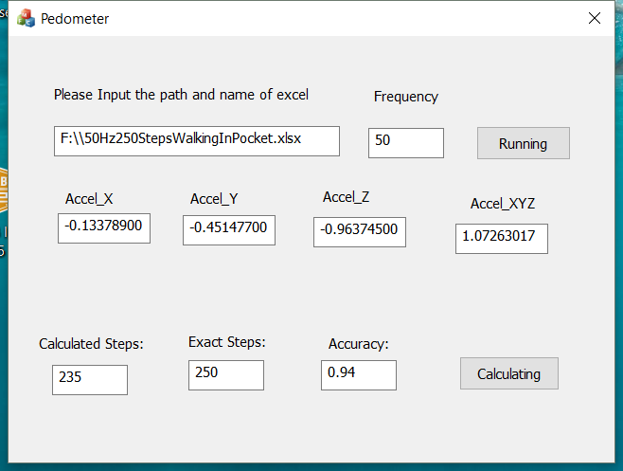
My Pedometer Porgram
Program Details:
Fill out the path of excel file of Accelerometer data and the test frequency before click Running.
Fill in the exact count steps in the Exact Steps, and click Calculating.
And What I have done for this research ?
This interface on the left using MFC , which can operate the excel file directly，is very convenient for researchers or beginners to study or research G-sensor and all they need to do is to collect data from their phone. (Lots of APPs can collect data in an excel file).
They can calculate the accuracy easily, only just need to count the exact steps by themselves. With the calculated steps and clicking the button, Calculating, can get the Accuracy.
My program interface

Slide 11
Accuracy Results from Preliminary Testing:
Action pattern | Placement of Iphone | Height | Weight | Age | ground condition | Frequncy | Number of step (exactly) | number of steps(by program) | Accuracy
Walking | in pocket of pants | 173cm | 60 Kilo | 28 | Flat | 25Hz | 150 | 250 | 0.60
Walking | in pocket of pants | 173cm | 60 Kilo | 28 | Flat | 50Hz | 235 | 250 | 0.94
walking | in hand(Natural Vertical) | 173cm | 60 Kilo | 28 | Flat | 50Hz | 243 | 258 | 0.94
Walking | Put the Phone Beside Ear (to answer the phone call) | 173cm | 60 Kilo | 28 | Flat | 50Hz | 192 | 250 | 0.77
Running | In pocket of Pants | 173cm | 60 Kilo | 28 | Flat | 50Hz | 258 | 250 | 0.97
Notes:
I just want to tell them I focus on the action recognition algorithm and this is a basic project I have to research, in the coming years I want to research motion recognition of shaking glow stick in the vocal concert using Gyroscope and Accelerometer

Slide 12
References:
1. Neil Zhao, A Step, Stride and Heading Determination for the Pedestrian Navigation System.
2. Jeong Won Kim, Han Jin Jang, Dong-Hwan Hwang, Chansik Park, A Step, Stride and Heading Determination for the Pedestrian Navigation System,Received: 15 Nov 2004 / Accepted: 3 Feb 2005.
Notes:
For this project, I focus on researching on action recognition algorithms. Through this project to let me have a clear understanding and I will organize and create some things or paper which can help some beginner or researchers like me to study this field knowledge earlier.
1.try to understand the algorithms and create a new ideas/algorithm, 2. organizing the knowledge for bringing Convenience for others.

